Slide 1
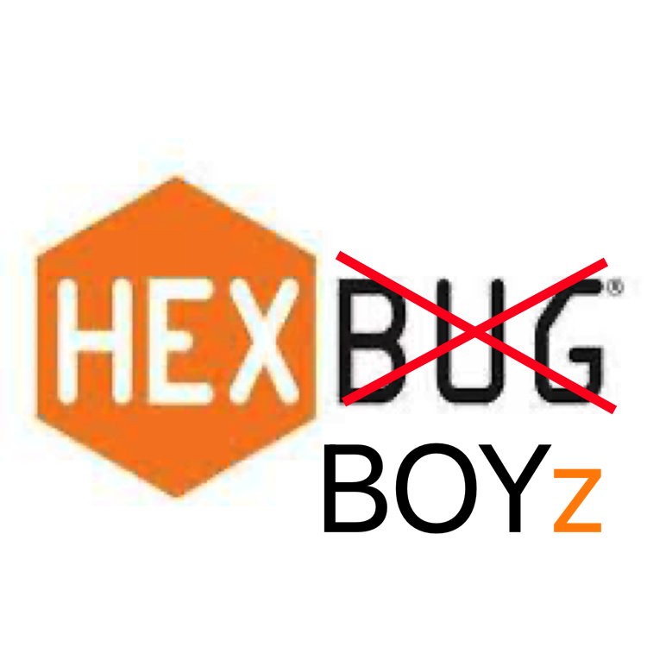
SA Presentation
HexBoyz - Dungeon Jump

Slide 2
Brief Introduction
Goal:
To return to Monkey
What is our game?
An alternating-perspective 2D collect-athon RPG
Involves monkeys, a human, and a coming of age story

Slide 3
Brief Overview (***Hexboy eyes only***)
Player wakes up on a deserted island. The player is human and they go through trials and tribulations setout for them by monkeys. The enemies they encounter in dungeons scattered throughout the overworld will also be monkeys. At the end of the game, it’ll be revealed that the reason the player was going through these trials was as a “rite of passage” and they’ll be accepted as one of the monkeys, with a big party involving all the enemies and helpful monkeys at the end. During this party, they’ll be able to converse with all the monkeys and understand them. During gameplay, the player will only ever “faint” since the monkeys don’t actually want to kill them.
Could add master oogway saying “mmmm…monkey” when game beaten
Could add “Successfully returned to monkey” when game beaten

Slide 4
Storyboard

Slide 5
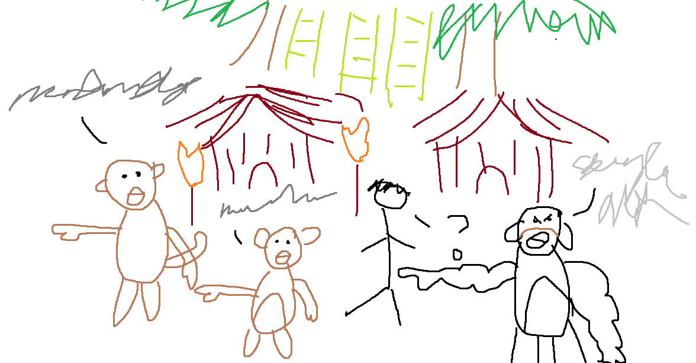
1
The human player will spawn inside a monkey village. All the monkeys they talk to talk in unintelligible noises. The player will be directed to the jungle.
Dialogue:
“Ooh ooh eeeeep!” *frantic pointing*
“The only way is forward it seems.”

Slide 6
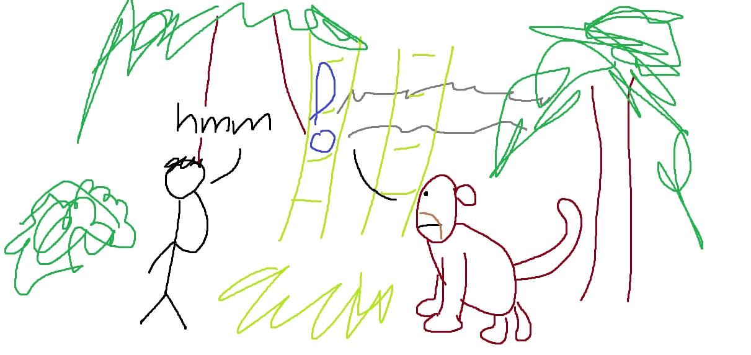
2
The player appears in the middle of the jungle. Walking around, they talk to a monkey who sends them on a quest.
Dialogue:
“Oo oo ah ahhhh AHHH AAAAH”
“Of course I’ll retrieve your lost ring.”
“Oo ooo ooooooooooooooooo”

Slide 7
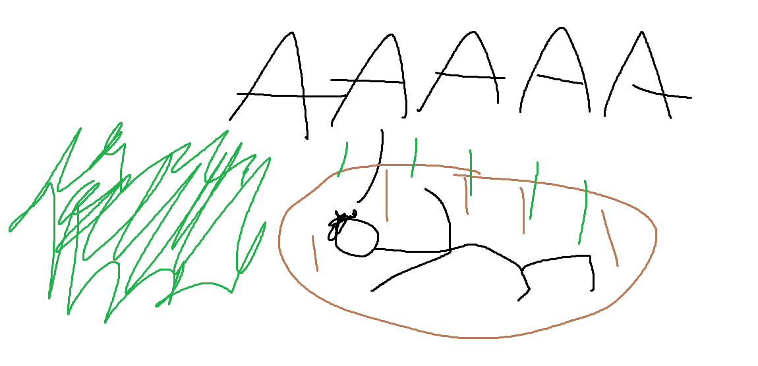
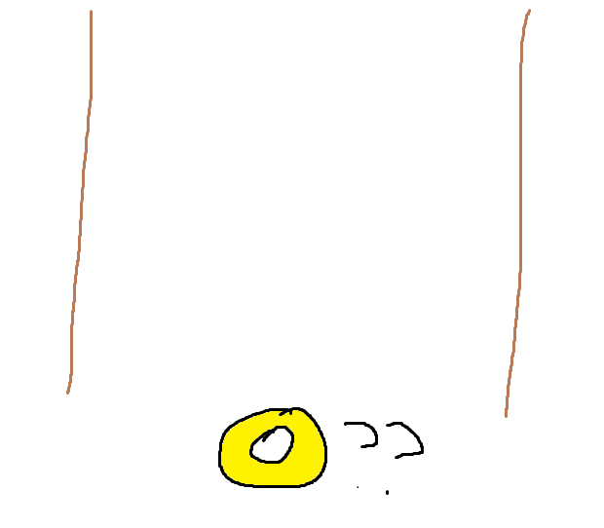
3
The player stumbles upon a hole in the ground. They fall in.
Action:
The player must defeat this level by finding the monkey’s lost ring without fainting.

Slide 8
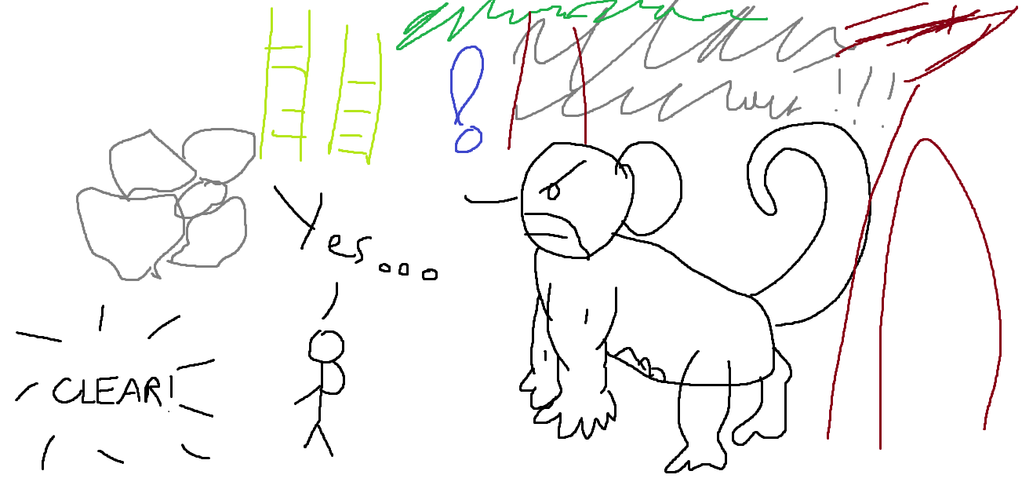
4
Returning the monkey’s ring, the player receives an item as compensation. Huge boulders blocking the path to the next area have been moved, and the player receives a new quest from the next area’s monkey.
Dialogue:
“Eeekeek ookeek”
“I agree, but is a walnut really that important?”

Slide 9
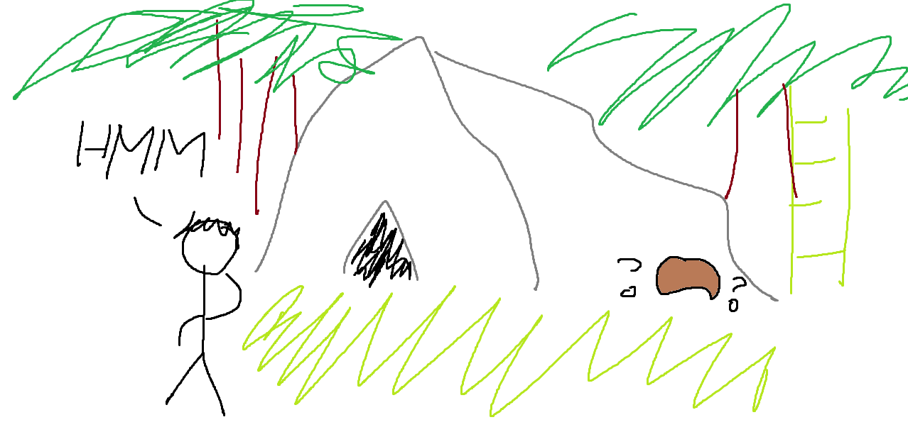
5
Following a river, the player finds the entrance to a cave which they feel the urge to enter.
Action:
The player must find the missing walnut in the coconut cave without fainting. Easy right?

Slide 10
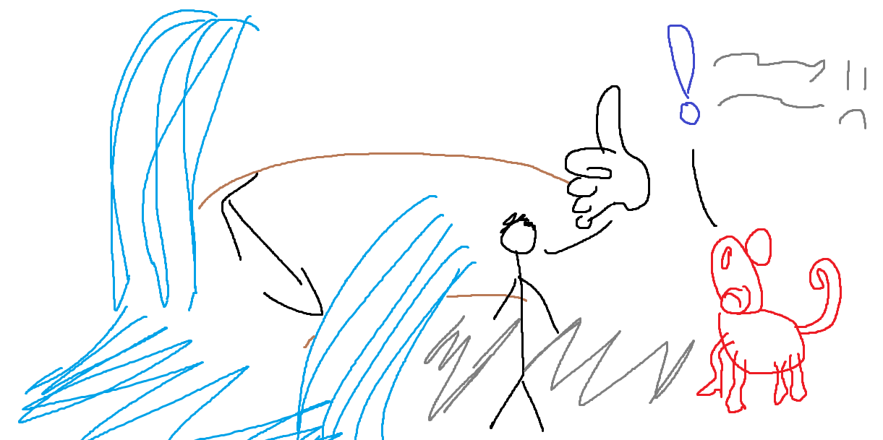
6
Finding the walnut, the player returns to the monkey and gives them the walnut, receiving an item and parting the waterfall to the next area. The player ventures into the area and receives another quest from a monkey.
Dialogue:
“Eeeeek oohooohooh uuugh eeek!”
“At least a glowing rock is more interesting than a walnut.”

Slide 11
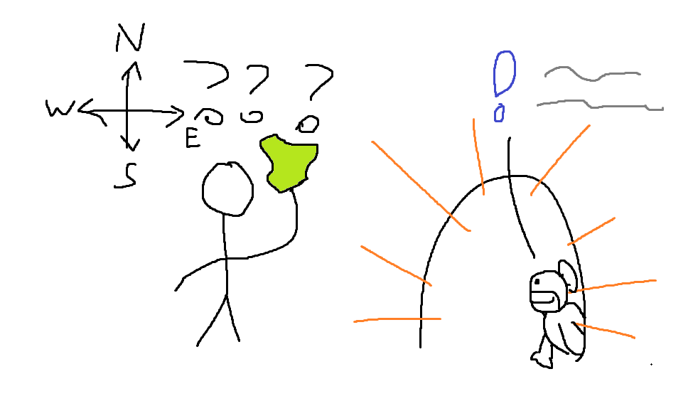
7
The game progresses in a similar fashion with the retrieval of the glowing rock, a new area opening up, and another item retrieval quest is given. But after completing this fourth quest, the player is given no direction.
Action:
Explore the world and find out if anything’s changed.

Slide 12
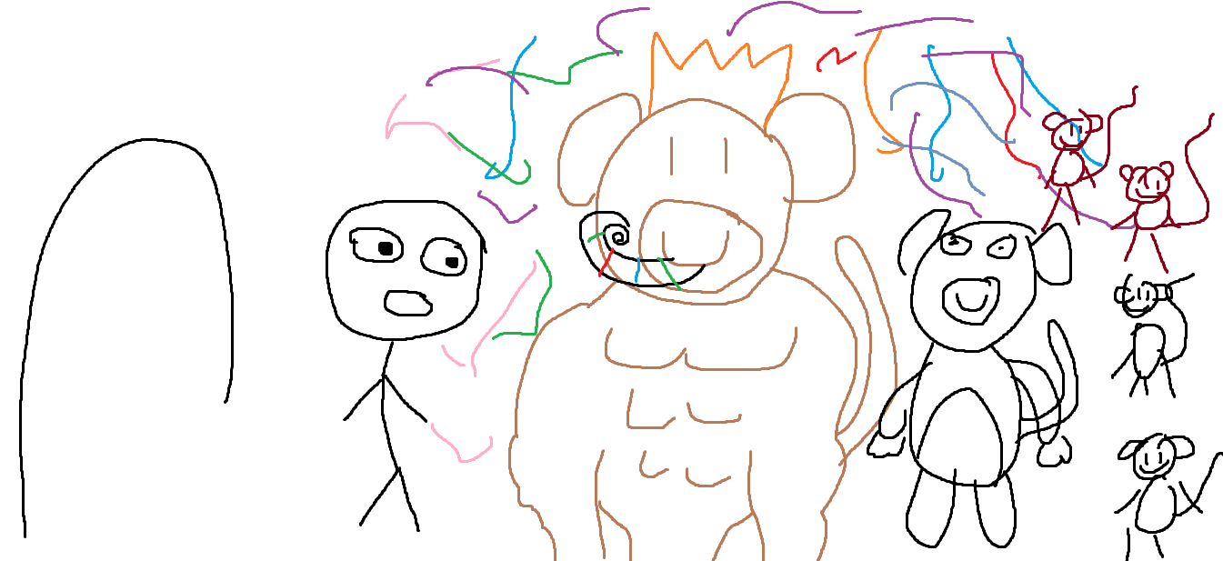
8
The player stumbles upon a building. Going in, all they see is black until the lights come on and confetti fills the air. It’s a party! All the enemies and friends the player’s made along the way are celebrating and its revealed that what the player just went through was a “right of passage”.
Dialogue:
“You’re one of us now.”

Slide 13
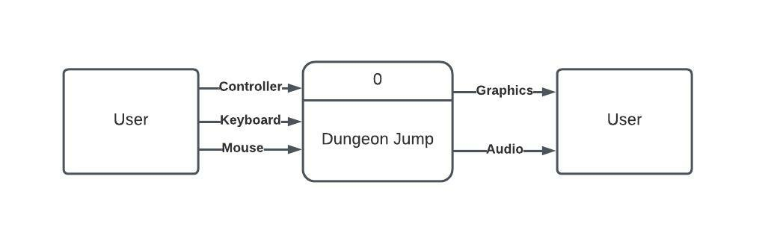
Introduction: Context Diagram

Slide 14
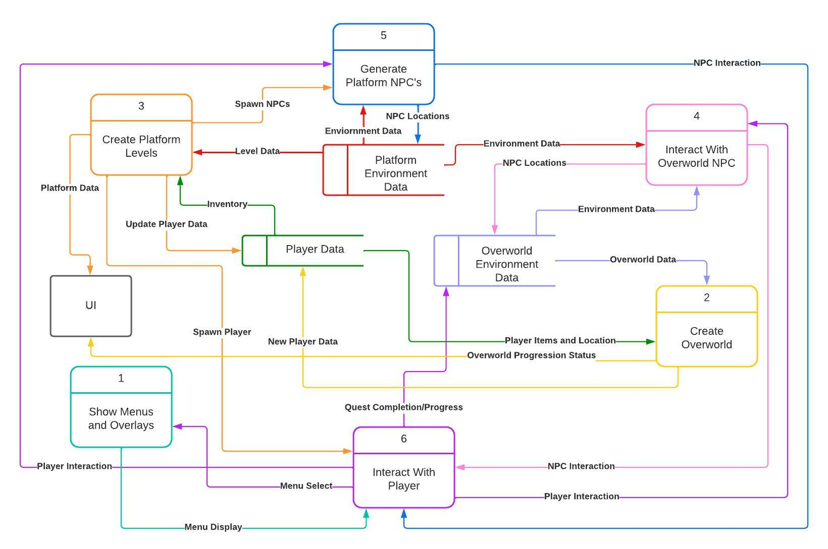
Data Flow Diagram 0

Slide 15
Global Use Case

Slide 16
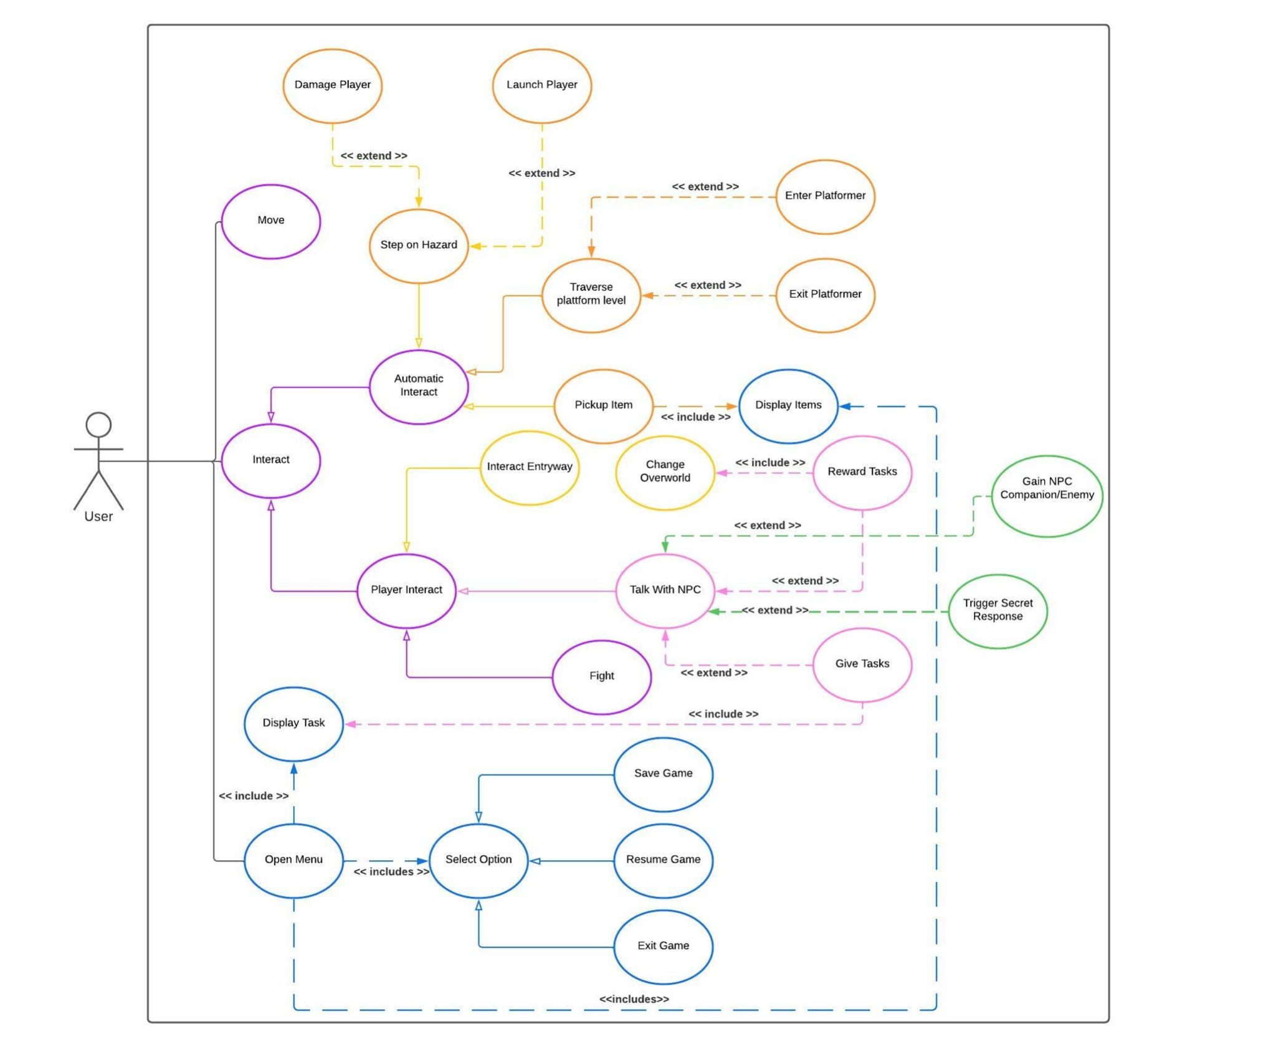

Slide 17
Individual Features

Slide 18
User Interface - Khoi Nguyen
Main Menu will be interfaced with to start or exit the game
Pause Menu will allow for exiting the game and viewing progress
Current quest, items obtained, controls
User interface will display player HP, zone/NPC info, touch controls
Priority: Low
A UI is a visual aid without which the game will technically pilot just fine
Useful to observe and debug the functionality of the game
Complexity: Low
Merely interfacing with other people's code
Design will be the most "organic" portion

Slide 19
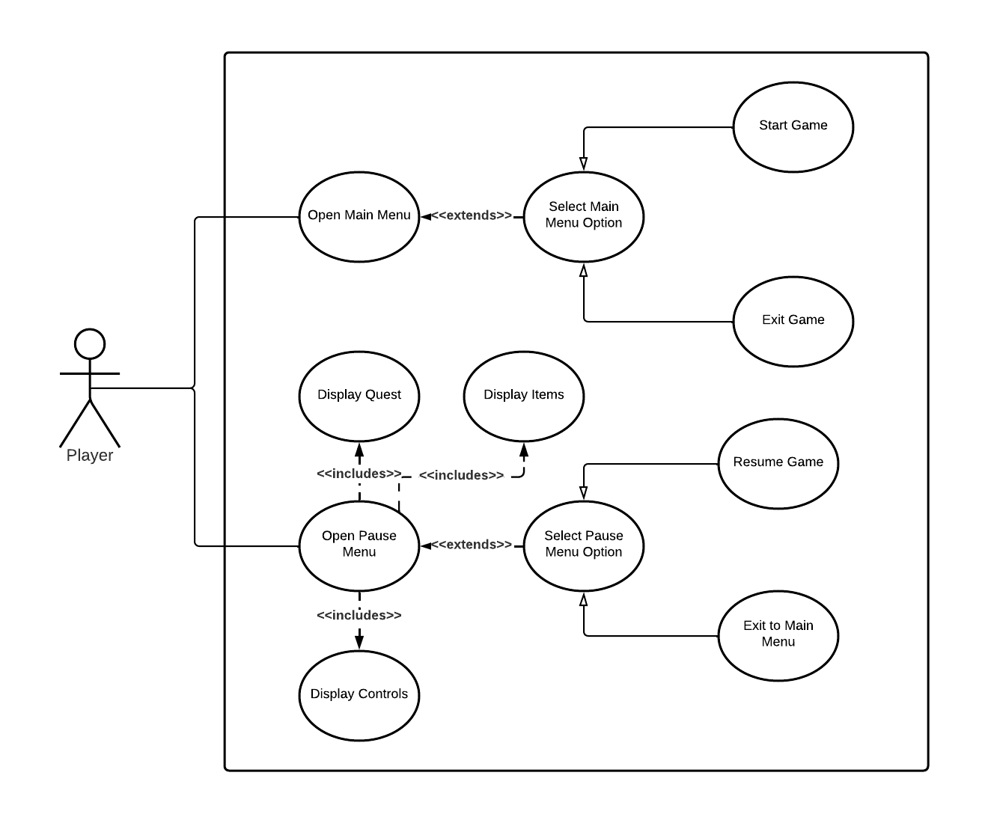
User Interface Case Diagram - Khoi Nguyen

Slide 20
Overworld Environment Builder - Seth Cram
Player needs an overworld environment to traverse and interact with
Will be linked to Platformer levels(aka dungeons) through level gates
Perspective will by top-down 2D
Priority: High
Player needs environment to travel from dungeon to dungeon and progress the story
Overworld NPCs need an environment to stand/move around on
Complexity: Moderate
Most art and general layout coming from the Unity store
More time for obstacles and minor details
Focused on hazards, level gates, items and buildings

Slide 21
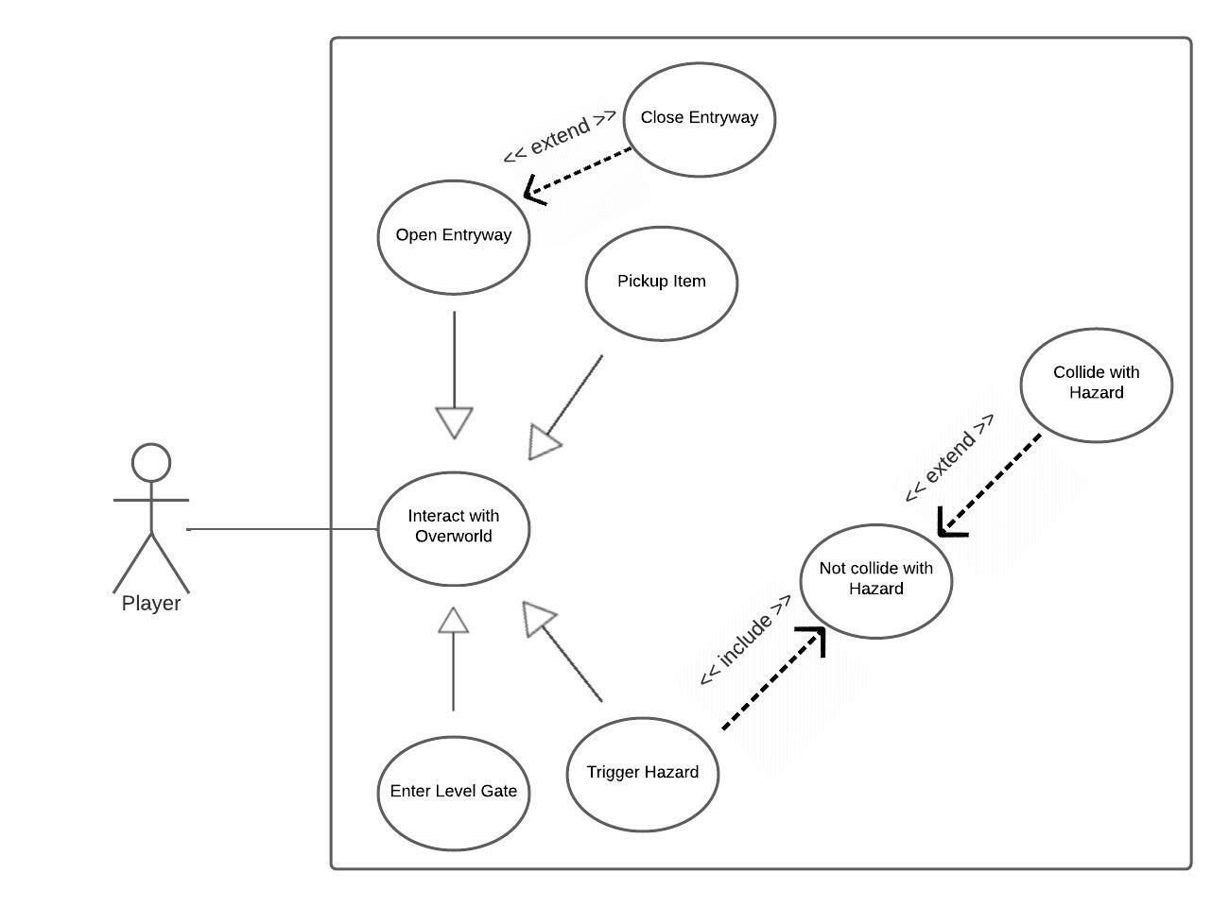
Overworld Use Case Diagram - Seth Cram

Slide 22
Overworld NPCs - Ethan Hinkle
When the player interacts with an NPC, they start a conversation and converse with the NPC
The NPC will give our guidance/quests to the player to do
Priority: Moderate.
The players interaction with the NPCs will give the player direction
Overworld (and by extension platformers) are blocked by NPC interaction
Could be replaced by other features with effort and game revamp
Complexity: Moderate
Unique dialogue options which convey meaning without words
Player responses will lead to different outcomes in conversation
Each NPC should feel unique in dialogue and appearance
Certain dialogue options will lead to world/player edits

Slide 23
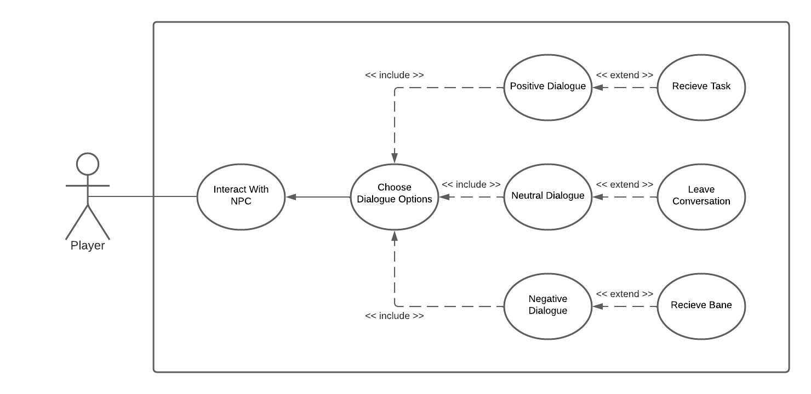
NPC Interaction Use Case Diagram - Ethan Hinkle

Slide 24
Platform Level Design and Creation - Chadwick Goodall
Player needs interesting dungeon levels to enhance gameplay
Links back to overworld sections at the level end
Perspective will be side scrolling 2D
Priority: High
Composes a majority of the actual gameplay of the game
The player as well as NPCs, such as monsters, require an environment to reside in
These are the main areas that drive the progress of the game
Complexity: Moderate
Assets and the like will be obtained in the Unity Asset store; potentially some custom assets will be used as well
Primary focus is on unique and engaging level design to create a fun game
Includes the creation of interactable tiles and items

Slide 25
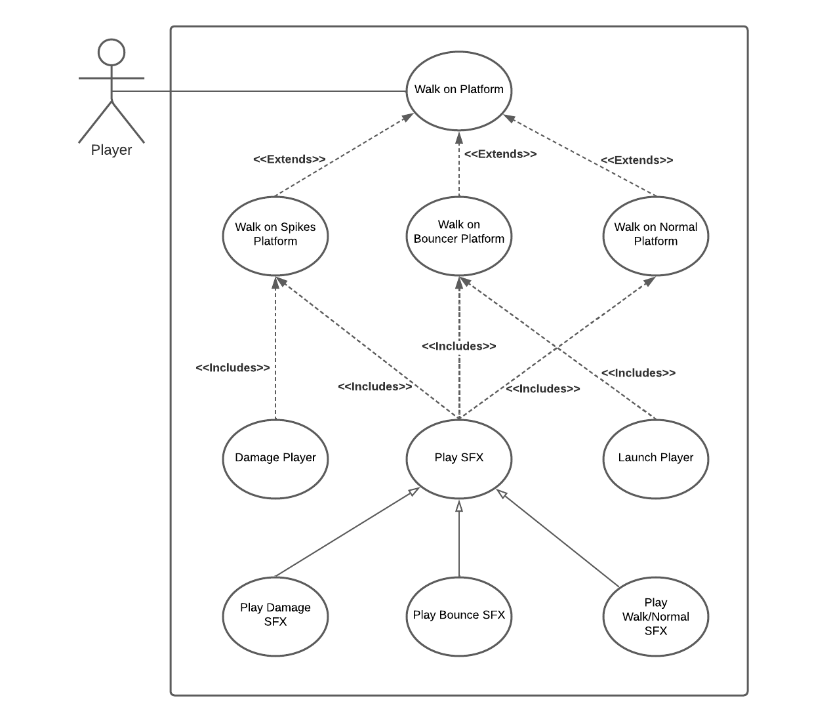
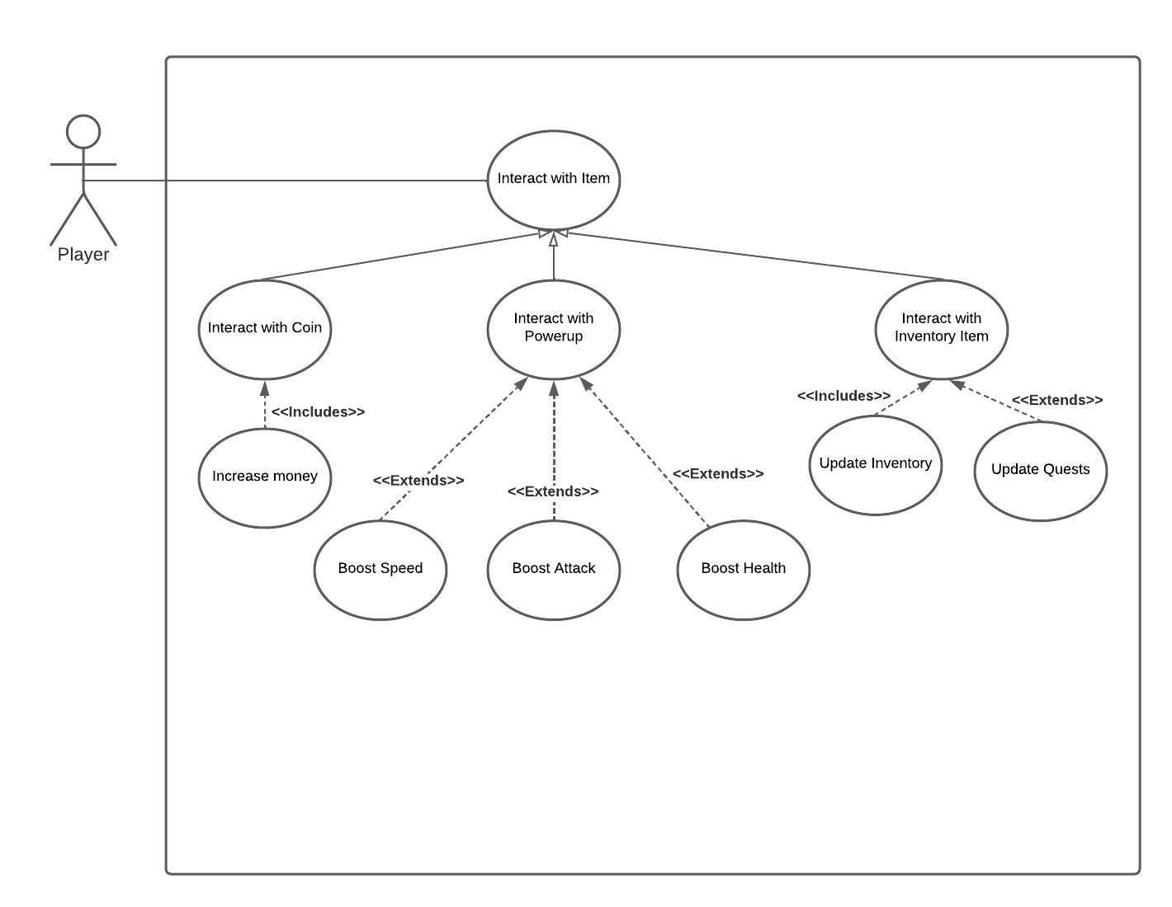
Platform Level Use Case Diagrams - Chadwick Goodall

Slide 26
Platform NPC Design - Dawson Burgess
When a player chooses to interact with an NPC, they can have a conversation.
Depending on interaction, the player can receive a companion for the level, or an NPC can become hostile to the player.
Priority - Low
Interaction with the most platform NPC’s is non-essential to game progression, with few exceptions.
Levels can be made easier or harder based on player choice.
Features could be added to make NPC’s can follow player for the rest of the game, and change platform terrain.
Complexity - Moderate
NPC’s need to be unique in appearance and dialog options from Overworld NPC’s and fellow Platform NPC’s.
Dialog options will lead to the player gaining a companion, enemy, or secret interaction.
NPC’s will need pathing and ability to attack players/enemies.

Slide 27
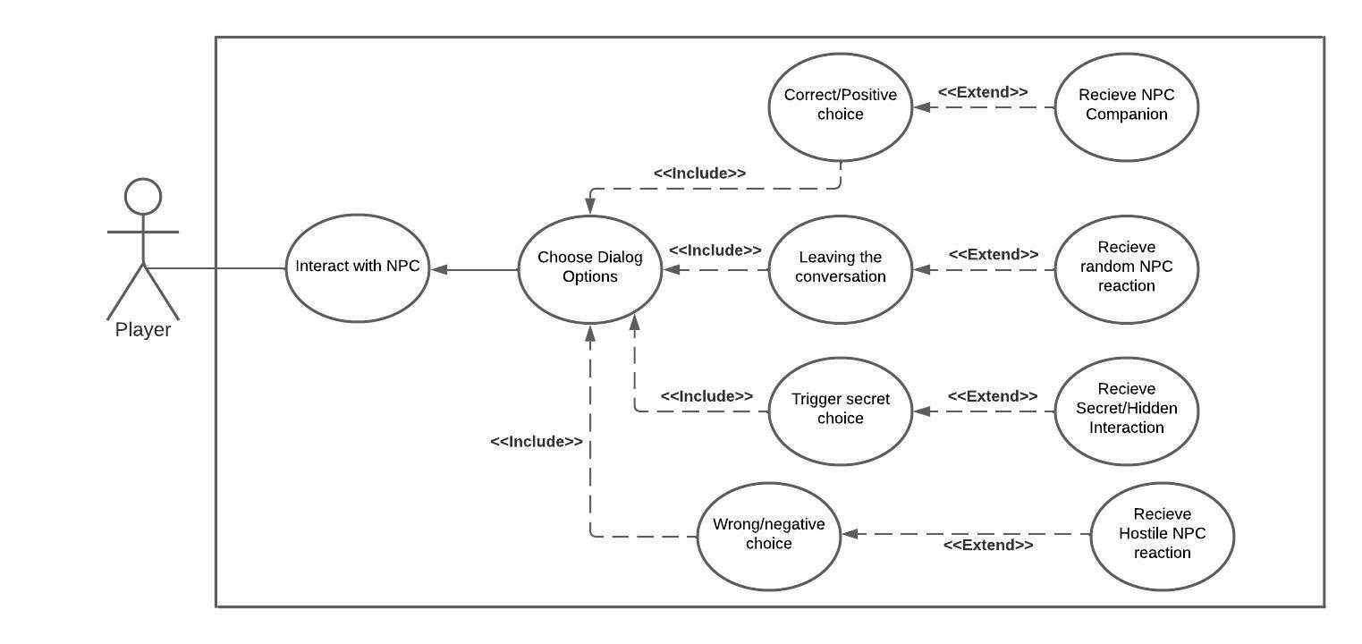
Platform NPC Use Case Diagram - Dawson Burgess

Slide 28
Main Player Design - Kurian Georly Kunnathushery
Main Player Movement
Player Can Move forward, backward, left and right.
Player can jump and fall while any obstacles found in way.
While player stops then player is in idle state.
NPC object Pickup
When pick up a NPC health objects then player Health value increases a fixed range.
Main player can pick up different weapons form the world and used while fighting.
Every Quest is a search for an item. Player wants to find that item and pick up that quest item.
Attack NPC
In Quest player wants face different kind of NPC enemies with different strength.
Player wants to attack the enemies and defeat them to move forward.
Player can use his weapon to defeat enemy. Player needs to find good choice of weapon.
Only one weapon can hold by the player at a time.
Defeating an enemy will increase player health status. And if player fails, will restart the Quest.
Priority: High
Overworld NPCs need a main player to complete the quest and the story.
The whole game depends on main player.
Complexity: High
Main player would be unique in appearance while comparing to NPC.
Pick up and attack will change health status in a fixed manner.
Weapon change by player depends depth of attack and determines defeat.
Main player’s existence determines the health status.
The whole game depends upon the movement of the main player.

Slide 29
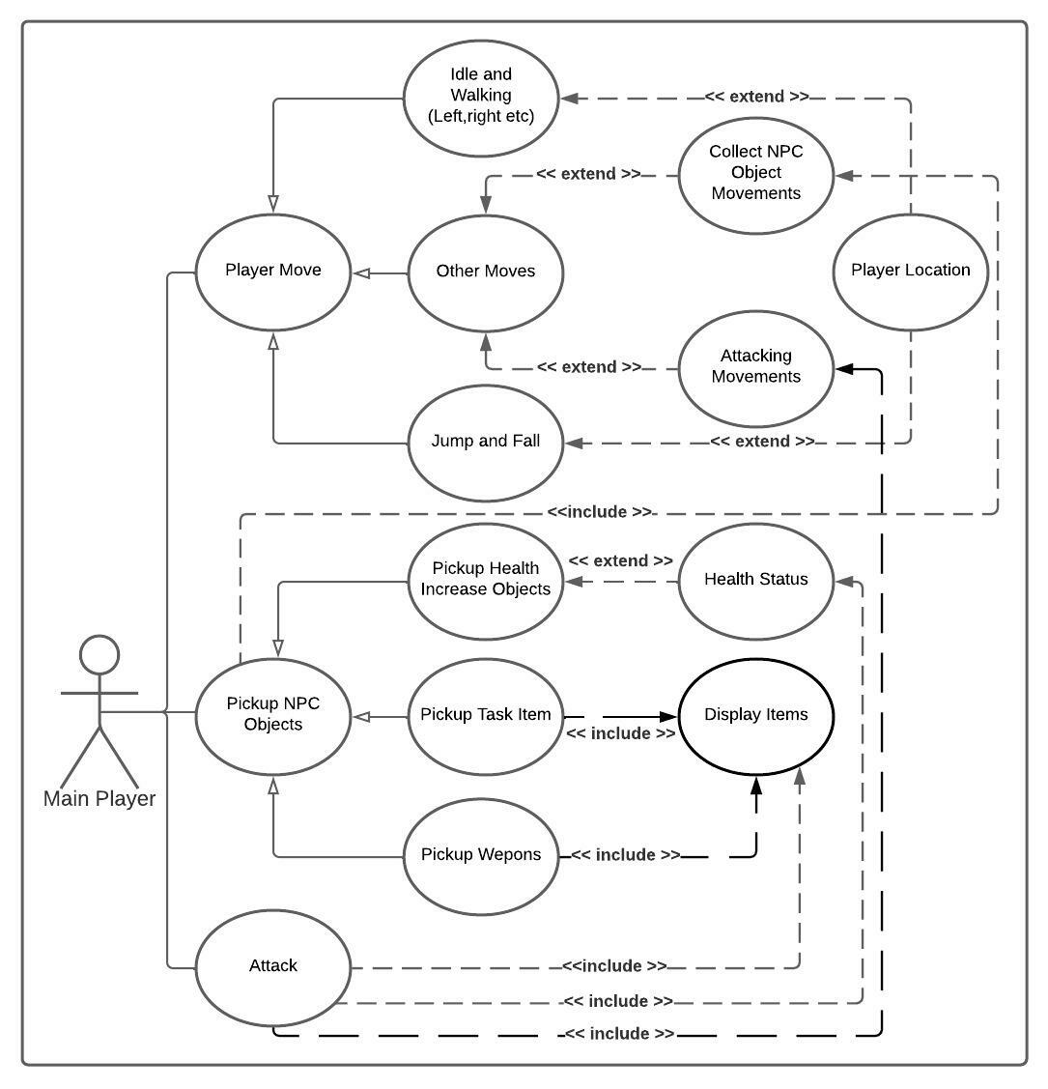
Main Player Use Case Diagram - Kurian Georly Kunnathushery

